Slide 1
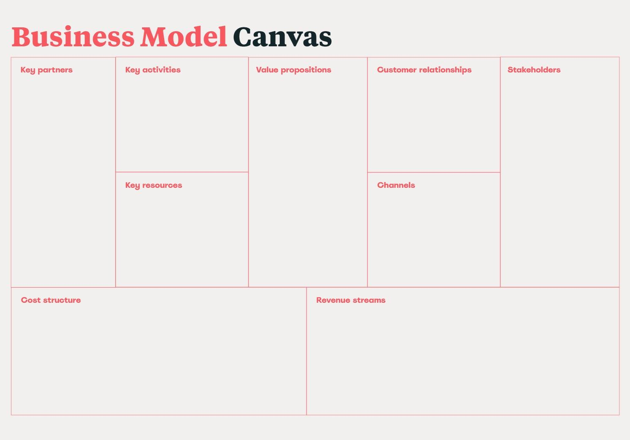
• Municipalities & Public Authorities
• Accessibility Advocacy Organizations & NPOs
• Smart City Technology Integrators
• Local Businesses & Associations
• Universities & Research Institutions
• Tourism Agencies & Accessible Travel Initiatives
• Platform Development & Maintenance
• Real-Time Accessibility Reporting
• Crowdsourcing Community Engagement
• Data Analysis
• Partnerships & Collaborations
• Marketing Campaigns
• Real-Time Accessibility Mapping
• Crowdsourced & AI-Enhanced Data
• Customizable UI/UX & Voice Commands
• Personalized Accessible Routes
• City Dashboard for Municipalities
• Dynamic Updates & Alerts
• Enhanced Independence & Mobility
• Crowdsourcing communities
• Partnerships with communities & organizations
• People with mobility difficulties
• Temporarily injured individuals
• Elderly people
• Parents with strollers
• Businesses
• Municipalities
• Technological
Infrastructure
• Database
• Financial Resources
• Human Capital.
• Mobile App (Android & iOS)
• Web App
• Social Media & Digital • Marketing
• Partnerships
• Software Development & Maintenance
• Technological Infrastructure
• Staff Salaries
• Marketing & Advertising
• Legal & Accounting Expenses
• Municipality Subscriptions
• Business subscriptions for Premium Advertising
• EU programs and grants

Slide 2
